Slide 1
VE230 Recitation Class 6
by Li Chunchao
2017/11/9

Slide 2
Short Review

Slide 3

Magnetic Field and Magnetic Forces
Magnetic field
Magnetic force on a moving charge
Gauss’s law for magnetism (two forms)

Slide 4
Sources of magnetic field
law of Biot and Savart
magnetic field of a straight current-carrying conductor
Ampere's law

Slide 5
Solving Problems

Slide 6
Magnetic force on a moving charge
There is a uniform magnetic field B along z axis and a uniform electric field E along y axis. If a charge q with mass m is static at t=0. Try to describe the trajectory of this charge.

Slide 7
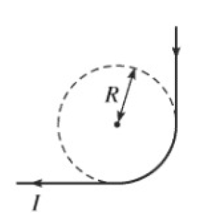
Law of Biot and Savart
A conductor shaped as shown in the figure carries constant current I. Find the magnetic field in the center of the circle.

Slide 8
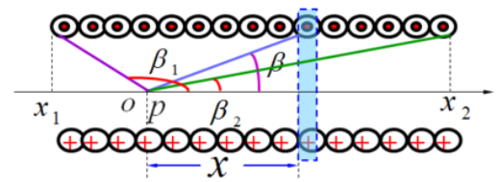
Law of Biot and Savart
If there is a not infinite long solenoid, the left side is β1 and the right side is β2, find the magnetic field at that point.

Slide 9
Ampere's law
If there is a coaxial-cable, I is uniformly distribute in the 0<r<R, -I on r=R.
Find the magnetic field in the space.

